Slide 1
Ephesians 3:14-19 (NIV)
14For this reason I kneel before the Father, 15from whom his whole family in heaven and on earth derives its name. 16I pray that out of his glorious riches he may strengthen you with power through his Spirit in your inner being, 17so that Christ may dwell in your hearts through faith. And I pray that you, being rooted and established in love, 18may have power, together with all the saints, to grasp how wide and long and high and deep is the love of Christ, 19and to know this love that surpasses knowledge--that you may be filled to the measure of all the fullness of God.

Slide 2
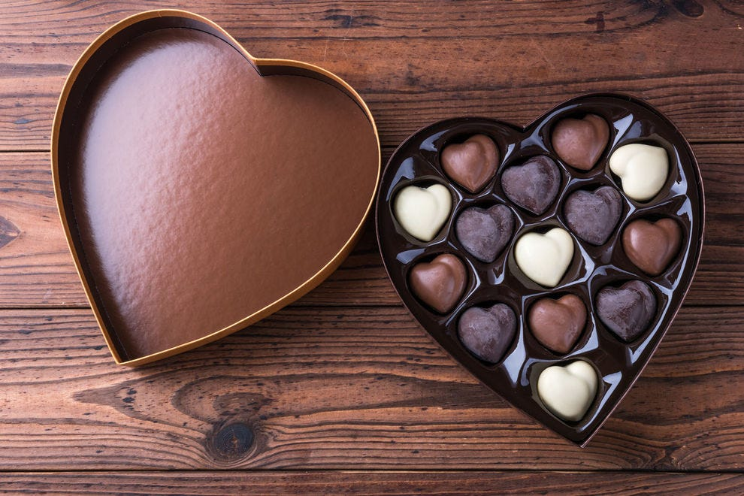
Family life
Like a box of
chocolates
Mother’s Day 2022
Kay Brown

Slide 3
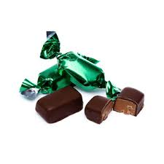
Chocolate Box Quiz
Soft Centre / Hard Centre

Slide 4
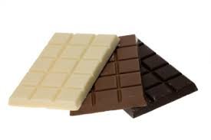
Chocolate Box Quiz
White / Milk / Dark

Slide 5
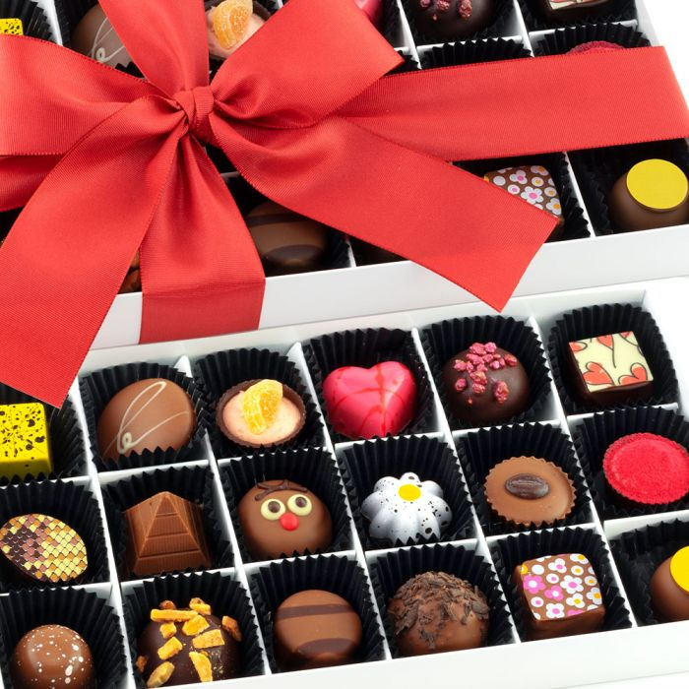
Chocolate Box Quiz
Nut variety/ Orange/ Caramel/ Coffee/
Strawberry/ Mint/ Turkish Delight

Slide 6
Chocolate Box Quiz
Soft Centre / Hard Centre
White / Milk / Dark
Nut variety/ Orange/ Caramel/ Coffee/
Strawberry/ Mint/ Turkish Delight

Slide 7
How do you eat a box of
Chocolates?

Slide 8
Family life
Like a box of
chocolates

Slide 9
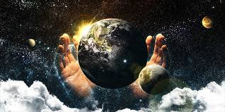
Family life in the Bible – God’s Family
Ephesians 3 14-19

Slide 10
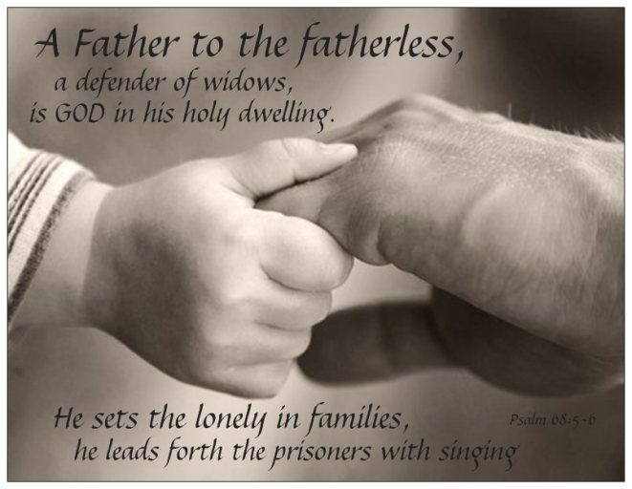
Family life in the Bible - dealing with the lonely
Psalm 68:5-6

Slide 11
Family life in the Bible - dealing with in-laws
Ruth and Naomi Old Testament book of Ruth
What is our response when life does not work out how we would like?
How do we relate to your in-laws?

Slide 12
Family life in the Bible - dealing with in-laws
Peter and his mother-in-law New Testament Mark 1:29-31
Are you supportive to your family?
Are you praying for your family and in-laws?

Slide 13
Family life in the Bible - creating family
Proverbs 18:24 There is a friend who sticks closer than a brother

Slide 14
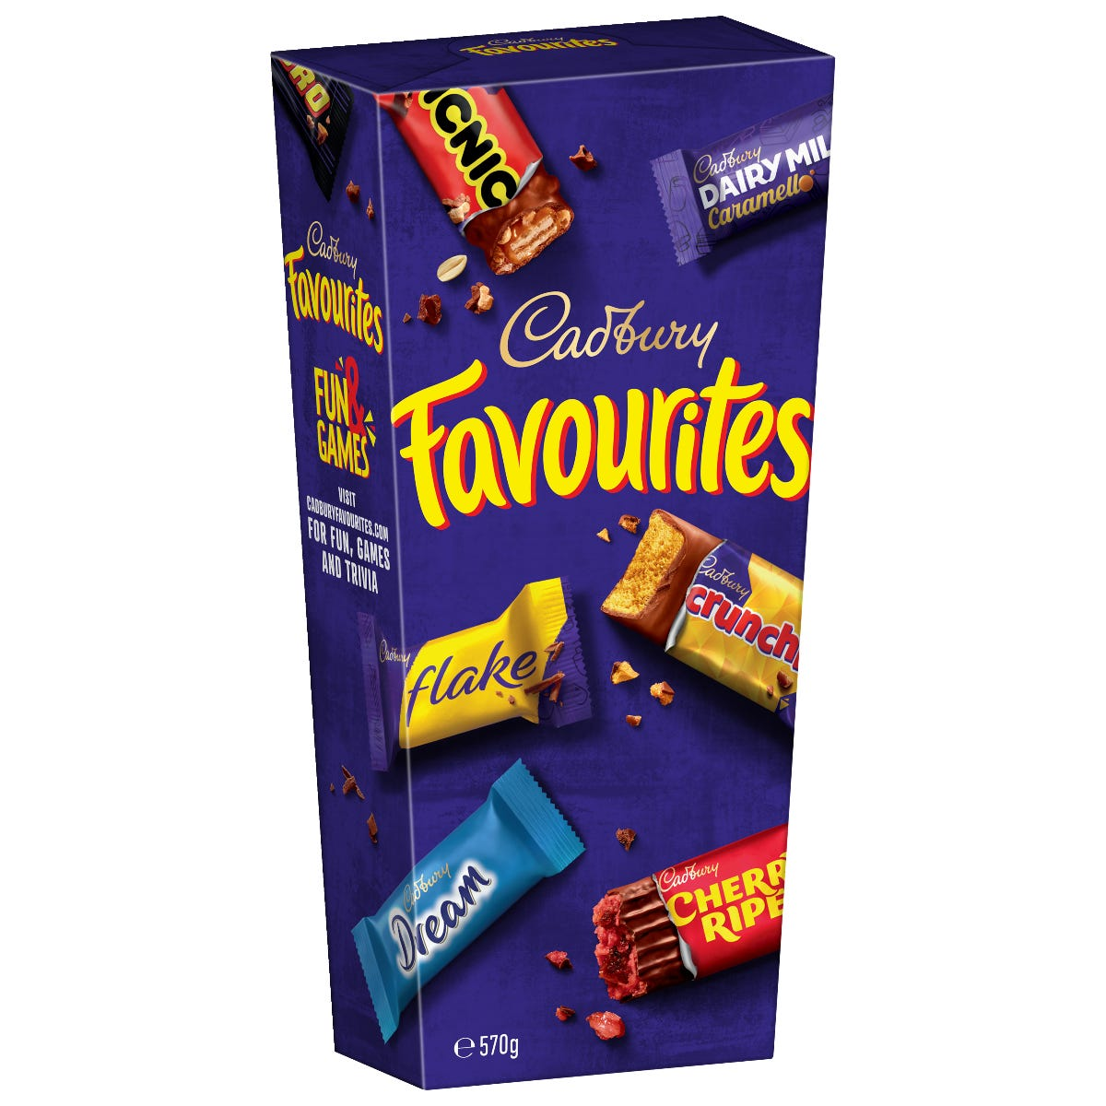
Family life in the Bible - favourites

Slide 15
Family life in the Bible - favourites
Genesis 25:19-34, 26-34-35, 27-33
Isaac and Rebecca and their twin sons Esau and Jacob
Romans 2:11 For God does not show favouritism
James 2:1 As believers in our glorious Lord Jesus Christ, don’t show favouritism

Slide 16
Family life
Like a box of
chocolates
Mother’s Day 2022
Kay Brown

